Slide 1
Python DeepLearning
컴퓨터공학과 전현우

Slide 2
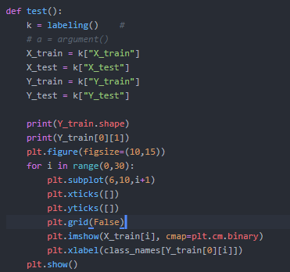
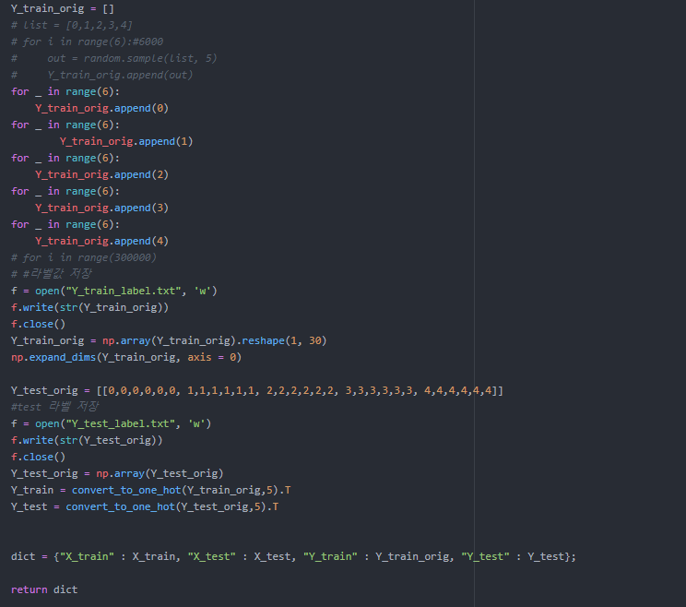
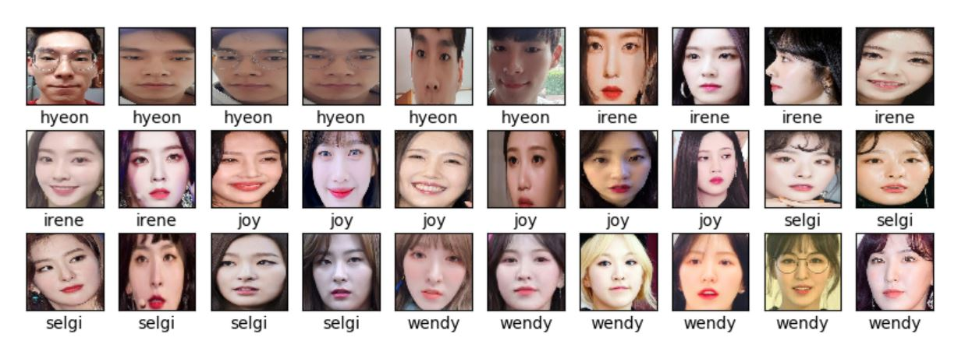
6
0. Labeling
Labeling
Test

Slide 3
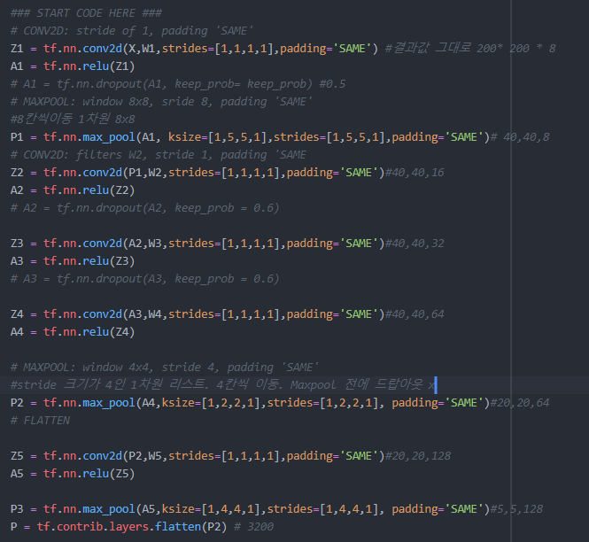
6
1. Tensroflow
Model
Trainset = 300장
Testset = 30장
Optimizer : Adam
Cost : tf.reduce_mean(tf.nn.softmax_cross_entropy_with_logits(logits = Z3, labels = Y))
Initializer : He Initializer
tf.contrib.layers.variance_scaling_initializer (seed = 0)
Minibatch size = 128
Learning_rate = 0.01
Num_epoch = 15

Slide 4
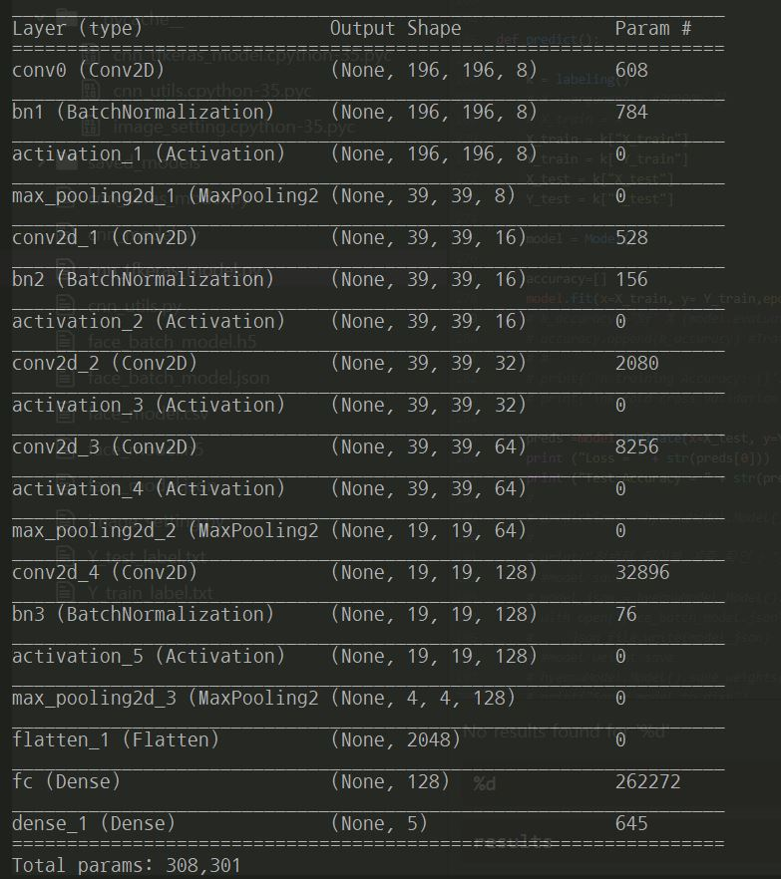
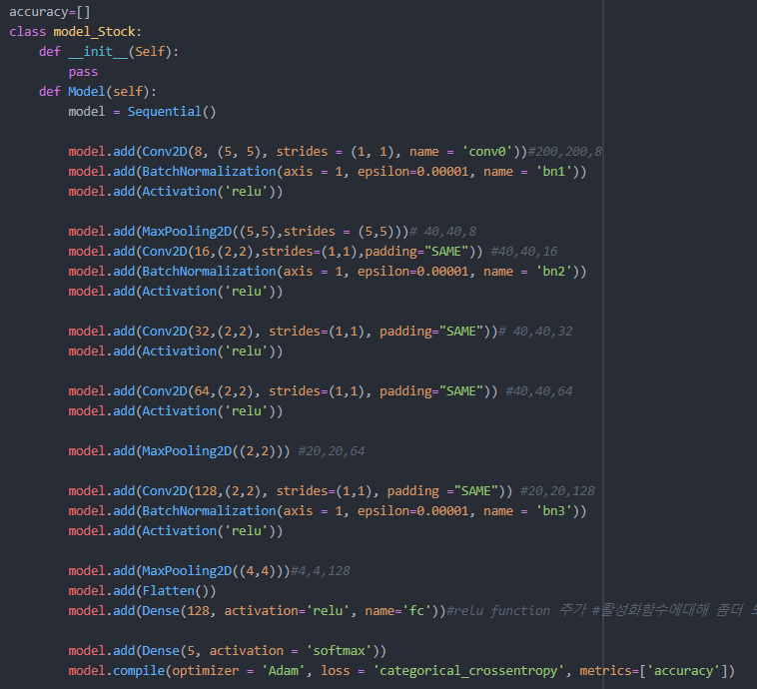
6
2. Keras Model
Model
Trainset = 3000장
Testset = 30장
-방법 -
Optimizer : Adam
Cost : tf.reduce_mean(tf.nn.softmax_cross_entropy_with_logits(logits = Z3, labels = Y))
Initializer : Xavier Initializer
-Hyper Parameter-
Minibatch size = 64
Learning_rate = 0.1
Num_epoch = 25

Slide 5
6
3. Summary
Model 요약
Total params : 308,301

Slide 6
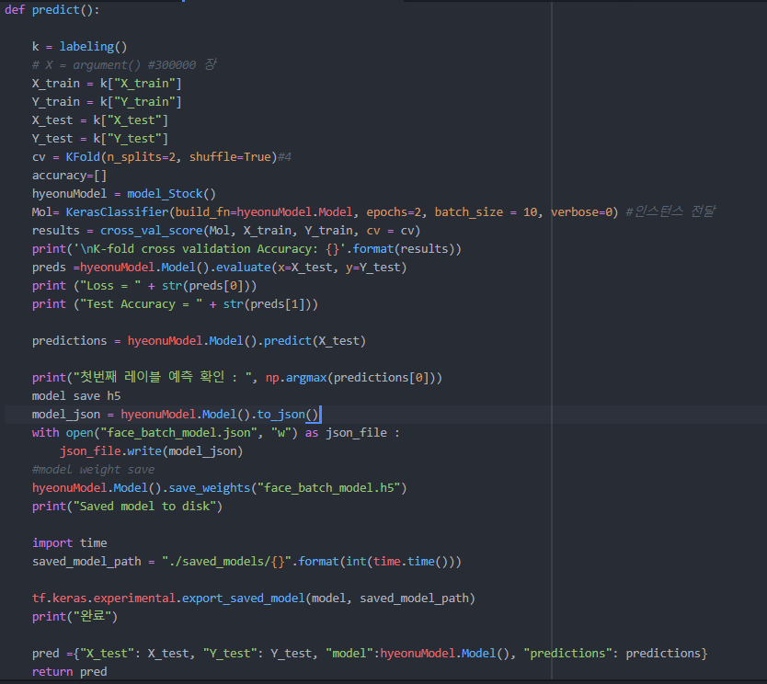
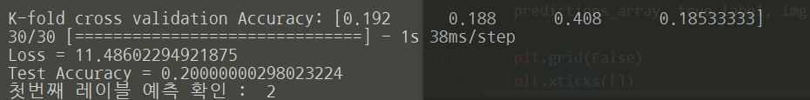
6
4. Kfold & Predict
Cross_val
stratifiedkfold
cv = Kfold(n_splits =4, shuffle = True)
Model.save_weights()
Model.save.to_json()

Slide 7
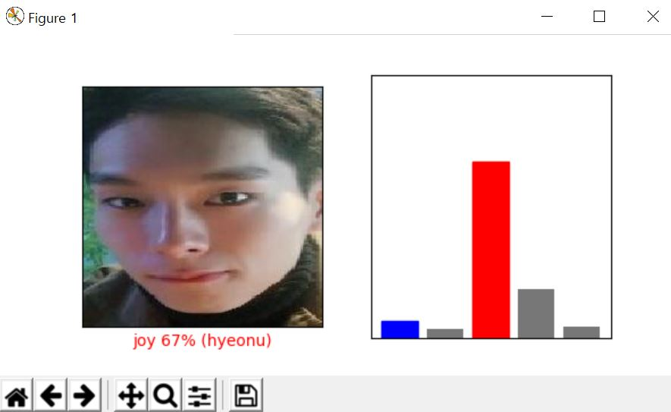
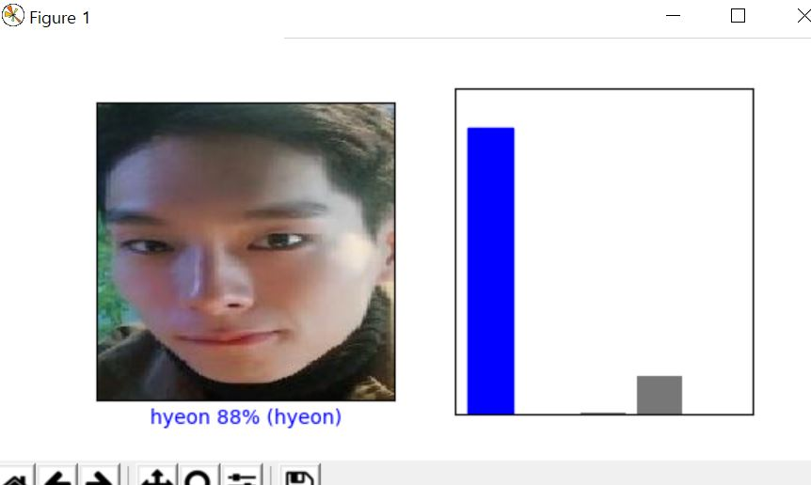
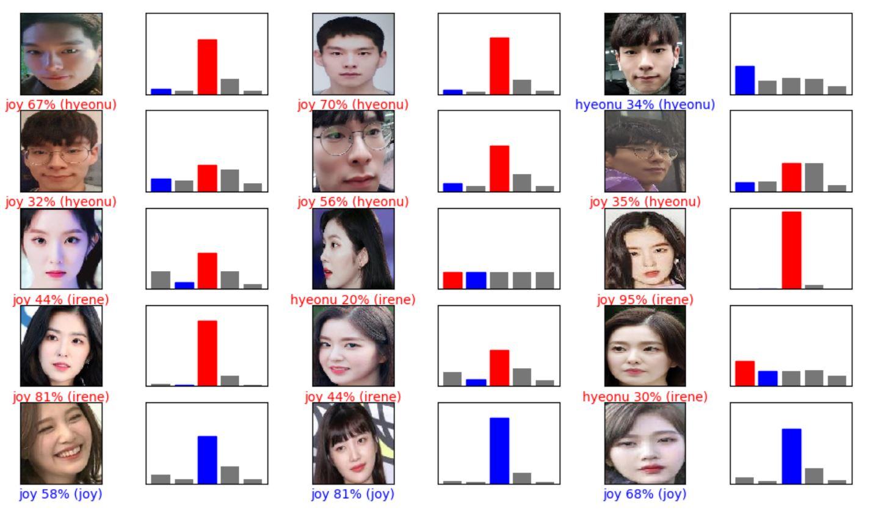
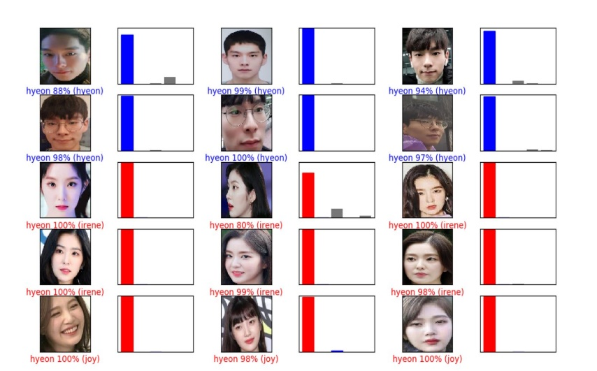
6
5. Visualization
epoch= 2
epoch= 25

Slide 8
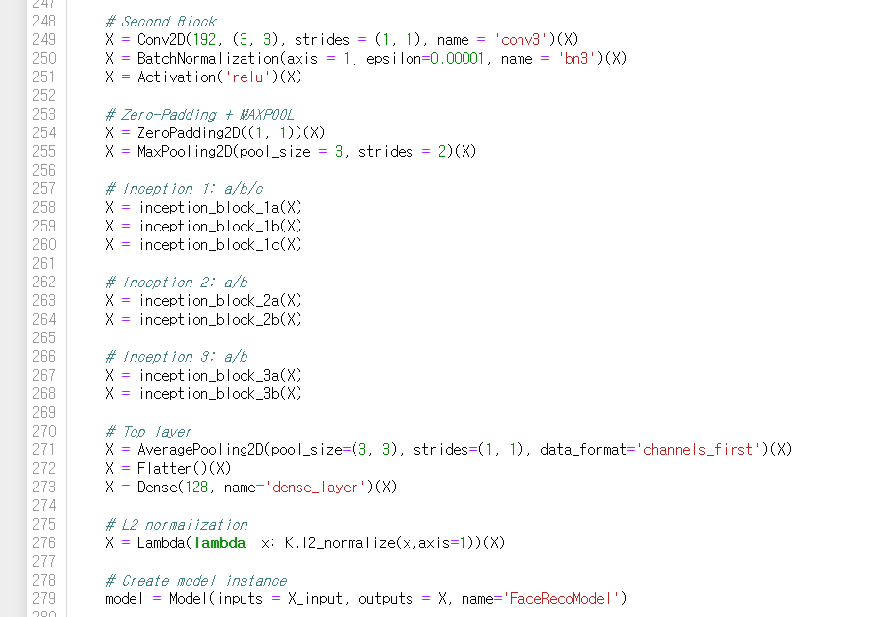
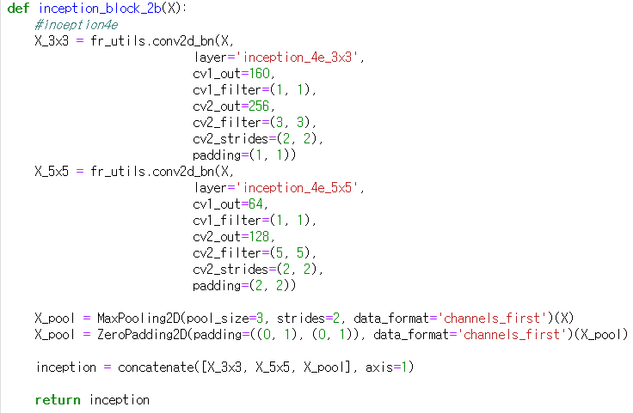
6
* inception Layer
* Lambda K.L2_normalization
6. FaceNet
Model

Slide 9
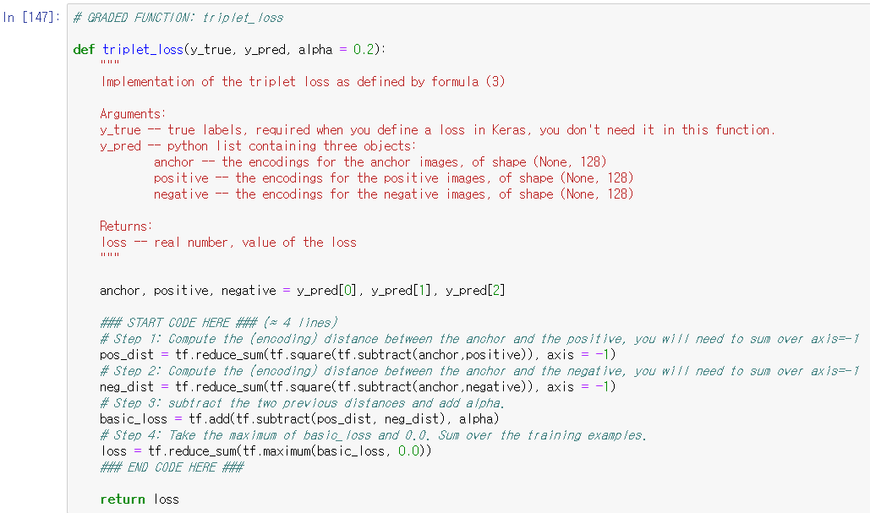
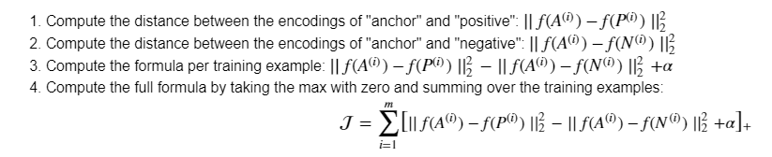
6
7. Triplet loss
수식

Slide 10
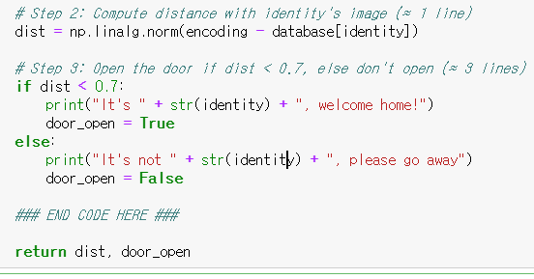
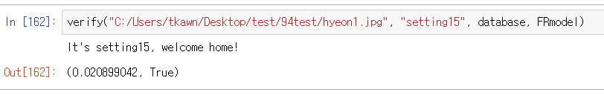
6
8. 얼굴 비교

Slide 11
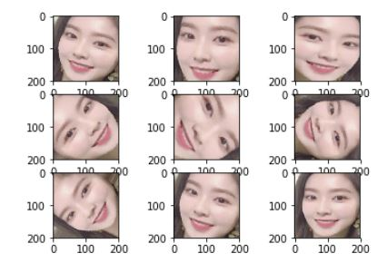
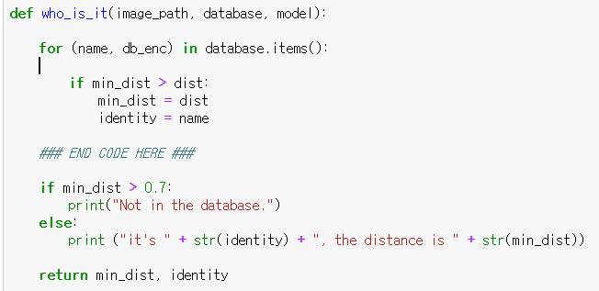
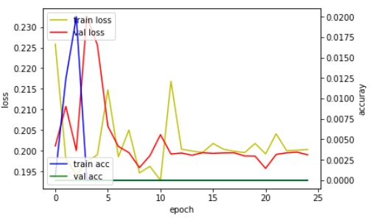
6
*Argumentation 문제
- rotation, brightness_range
Optimizer “Adam”
Loss = triplet_loss
Metrics= “accuracy”
Epochs = 25
Batch_size = 64
Validation_set = 0.3
Test acc = 30%
9. Who_is_it

Slide 12
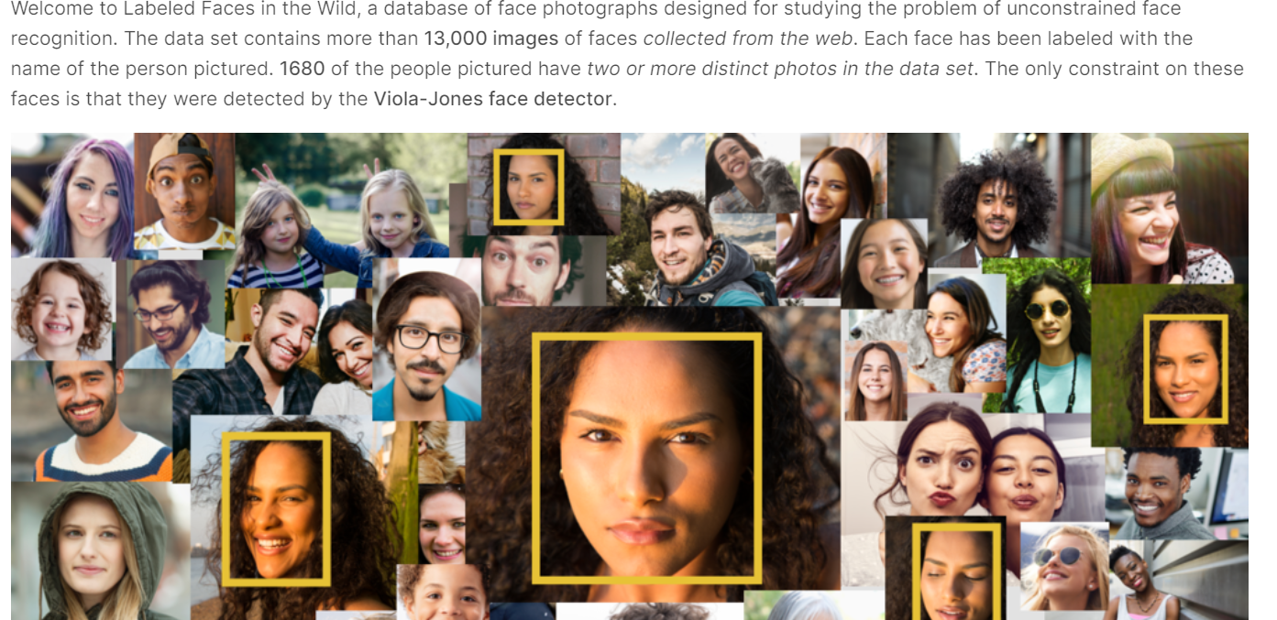
6
*Argumentation 문제
- rotation, brightness_range
10. 오픈 데이터셋 kaggle
13000 images
1680 people
Viola-Jones face detector
https://www.kaggle.com/atulanandjha/lfwpeople

